Slide 1
Advanced Algorithms Project, A.Y. 2018/2019
Lorenzo Pratissoli

Slide 2
The Problem - String Matching
Alphabet A of size |A|
A text T, from the alphabet, of size |T|
A pattern P, from the alphabet, of size |P|
Find the first occurrence of P in the text T
Example:
T: ABBA BA BAC AB
P: BAC
Output: 8 (assuming indexing from 0)
Notes:
natural extension

Slide 3
Naive Algorithm
Align the pattern to each position in which it could occur in the text from left to right
Check at that alignment, from that position on, if the pattern matches the text
Example:
Text: ABBA BA BAC AB, Pattern: BAC
ABBA BA BAC AB
BAC
BAC
BAC
BAC
BAC
….
BAC ← MATCH!

Slide 4
Naive Algorithm - Complexity
Time: O(|T| * |P|)
Constant auxiliary space

Slide 5
Boyer Moore Algorithm
Characters of pattern are matched with text from right to end
This way it is possible to proceed in jumps according to two rules
“Delta1” skipping rule
“Delta2” skipping rule

Slide 6
Boyer Moore Algorithm - Delta1 skipping rule
At character C of text mismatch skip to the position of C rightmost occurrence in the pattern
Skip |P| if character is not present in the pattern
Example
Text: ABBA BA BAC AB, Pattern: BAC
ABBA BA BAC AB
BAC
[BAC]
BAC
BAC
BAC ← Match!

Slide 7
Boyer Moore Algorithm - Delta2 skipping rule
Exploits a part of the pattern that has been matched
Example - partial skip
Text: ABAABABA, Pattern: CABAB
Example - full skip
Text: ABCABABACB, Pattern: CBAAB
ABAABABA
CABAB
CABAB
ABCABABACB
CBAAB
CBAAB
Notes:
note in the first partial skip it is ok because C != B before AB

Slide 8
Boyer Moore Algorithm - Complexity
Preprocessing time
O(|P| + |A|)
Time
Worst case O(|T|)
On the average we expect a sublinear(with respect to |T|) behavior because of expected skips
Theorem from [1]:
If the text does not contain any occurrences of the pattern, the total number of characters matched is at most 6 * |T|.
O(|P| + |A|) auxiliary space
[1] Knuth, D.E., Morris, J.H., and Pratt, V.R. Fast pattern matching in strings. TR CS-74-440, Standford U., Standford, Calif., 1974

Slide 9
Implementation details
BoyerMoore
Uses both delta1 and delta2
Skips ← max(delta1, delta2)
BoyerMooreSimple
Uses just delta1

Slide 10
Rabin Karp Algorithm
Rather than compare plain strings compare their “fingerprints”
Example
We want to check if “ABC” == “ABD”
Assuming the fingerprint function is the sum of ascii values
fingerprint(“ABC”) = 65 + 66 + 67 != fingerprint(“ABD”) = 65 + 66 + 68
On match
Trust the fingerprinting function(hopefully no false positives)
Algorithm 1
Check effectively that the two strings are the same by comparing each character
Algorithm 2 and 3

Slide 11
Rabin Karp Algorithm
Algorithm 1 tries to be more robust by computing k fingerprint function
Algorithm 3 changes the fingerprint function on a false positive match

Slide 12
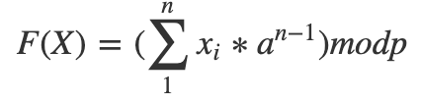
Rabin Karp Algorithm - Rolling property
As we scan through the text we would like to compute the fingerprint incrementally paying a constant cost at each step
For example if using the following fingerprinting function
Text: ABCD, Pattern=BC, a=2, p = 13
Initial text hash F(AB) = (2*65 + 66)mod(13)
Next text hash F(BC) =
[(F(AB) - 2*65)*2 + 67] mod(13) =
2*66 + 67 = F(Pattern) = F(BC) = (2*66 + 67) mod(13)

Slide 13
Rabin Karp Algorithm - Complexity
Preprocessing time
O(|P|)
Time
O(|T|)
always case in Algorithm 1
Worst O(|T| * |P|)
in Algorithm 2
and in Algorithm 3 ( + cost for changing the fingerprint function )
Constant auxiliary space

Slide 14
Implementation details
All the three kind of RabinKarp are implemented
Rabinkarp1 is parallelized using OpenMP

Slide 15
Galil Seiferas Algorithm
Given p, q the position in the text and in the pattern respectively while matching
Naive algorithm uses the following update rule
q ← q+1 to move on the pattern
(p, q) ← (p+1, 0) ← to move on the text
Given the definition of reach(p) of a given word w
A prefix w[0...p] of w is a prefix period of if it is basic(not in the power form) and reach(p) >= kp

Slide 16
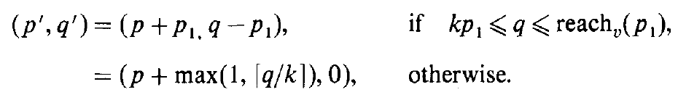
Galil Seiferas Algorithm
Galil Seiferas uses the following update rule instead
This rule works assuming that the pattern p has been decomposed
p = uv such that v has at most one prefix period
p1 is the length of that prefix period
Preprocessing consists in finding the decomposition
k determines the time complexity
for k → inf, reduction to naive

Slide 17
Galil Seiferas Algorithm - Complexity
Preprocessing time
O(|P|)
Time
O(|T| + |P|)
Constant auxiliary space

Slide 18
Performance Analysis
Macbook Pro mid 2014
2,6 GHz Intel Core i5, dual core, 8 gb of ram
Algorithms are implemented in C++
GCC 6.4.0_2
Optimization flag: -O3
Execution time includes also the eventual preprocessing time
30 samples, per time measurement, are averaged
Random strings and random pattern

Slide 19
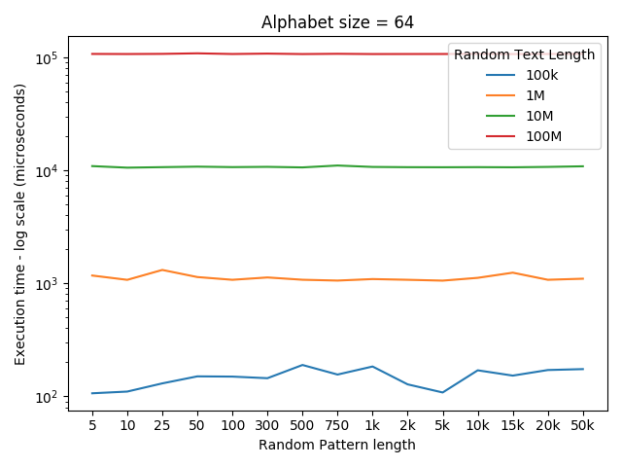
Naive Algorithm

Slide 20
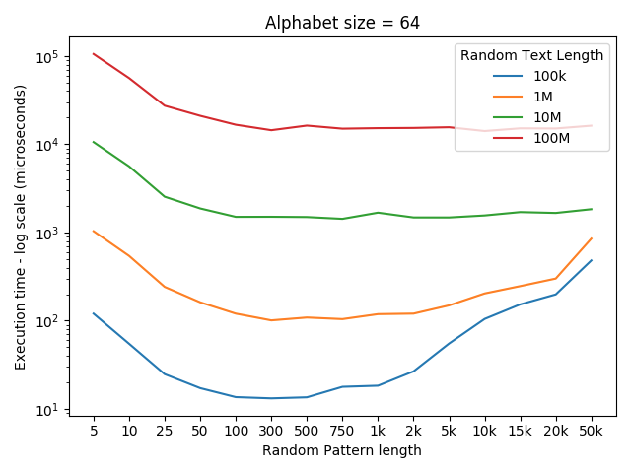
Boyer Moore Algorithm
Notes:
Long pattern → potentially we can skip more

Slide 21
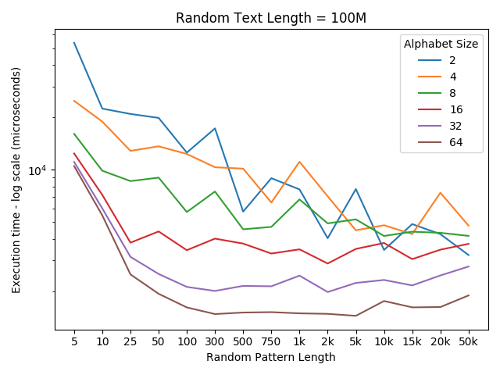
Boyer Moore Algorithm
Notes:
Small alphabet small pattern worse than small pattern large alphabet → char in text not going to be in pat so skip full word
Small alphabet → Substrings tends to appear frequently, less skip

Slide 22
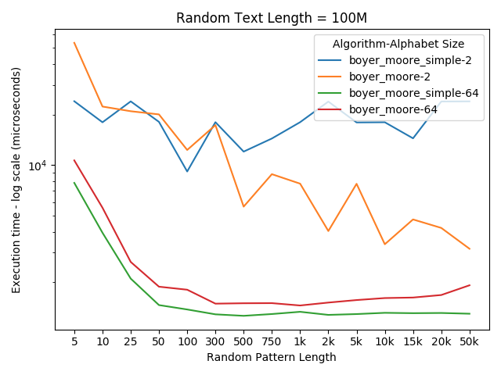
Boyer Moore Algorithm

Slide 23
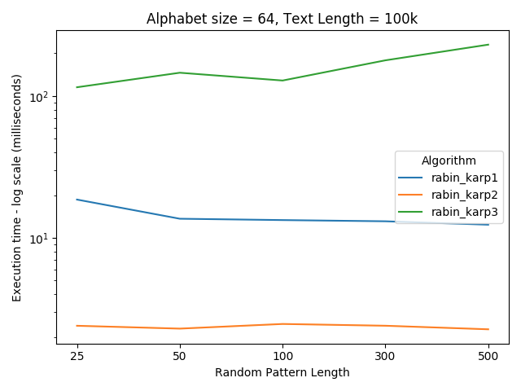
Karp Rabin Algorithm
RabinKarp1 computes k=10 fingerprint functions(no OpenMP)

Slide 24
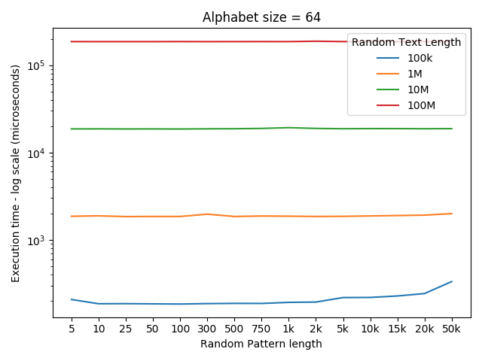
Galil Seiferas Algorithm

Slide 25
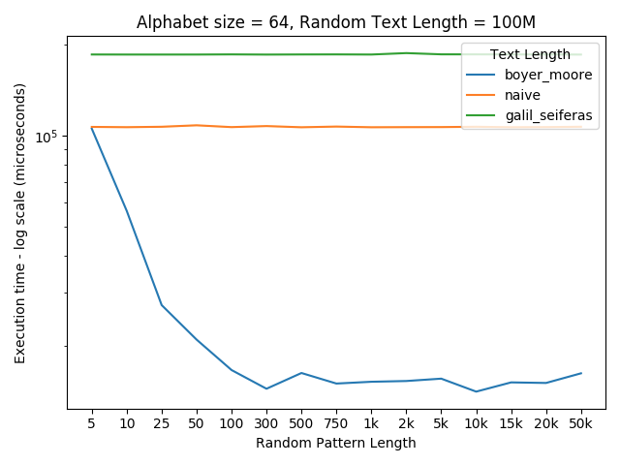
Final comparison
Do not forget memory requirements
Do not forget application domain

